Slide 1

Planning and Designing a Regional Biosolids Treatment Hub
Angus Wilkie

Slide 2

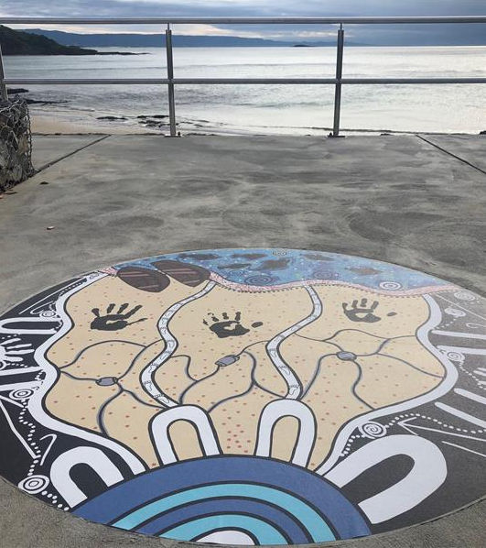


Acknowledgement of Country
Sydney Water respectfully acknowledges the traditional custodians of the land and waters on which we work, live and learn. We pay respect to Elders past and present.
Notes:
Sydney Water respectfully acknowledges the Gadigal people of the Eora nation and the dharug people, that traditional custodians of the land on which we meet and those of the lands and waters which the St Marys WRP services. We pay respect to Elders past and present.

Slide 3
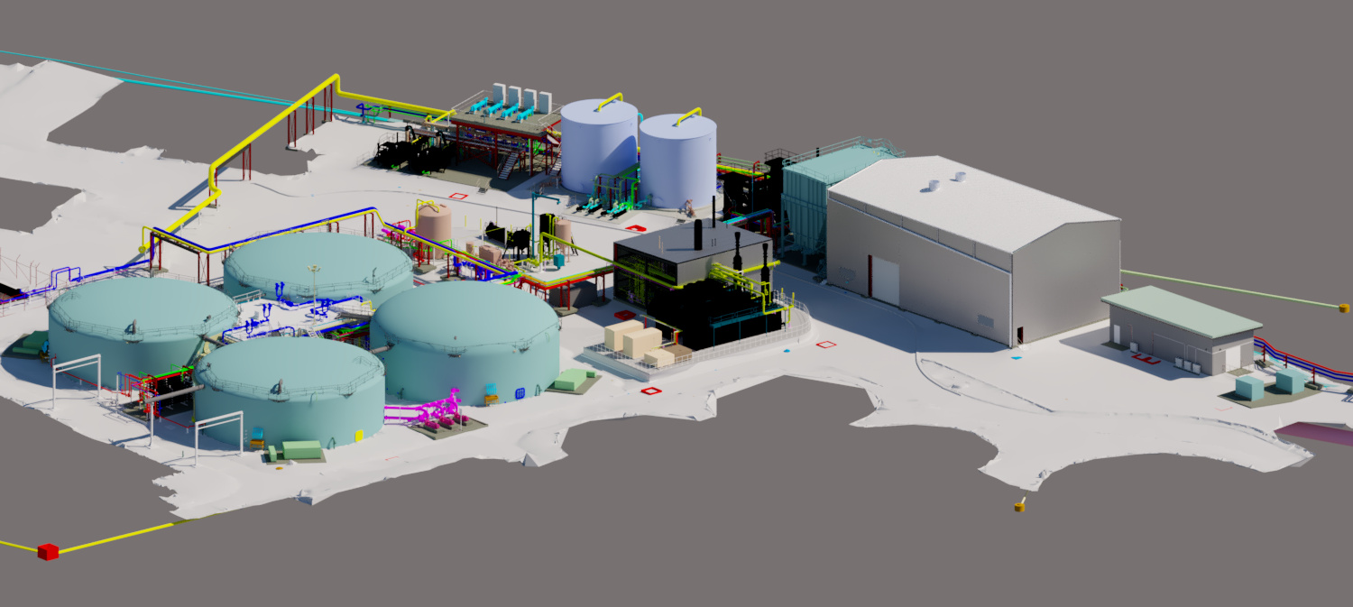

Notes:
Thanks very much for joining me today. Introduction of me.
This presentation will be focussing on the St Mary WRP Biosolids hub, which is a regional hub, designed to manage the biosolids from two treatment plants, St Marys WRP and Quakers Hill WRP.
My perspective on the project is part of the planning and design team which incorporated Sydney Water, and a JV of Aurecon and AECOM over a number years..
I’ve split up the content to cover some of the wider planning strategy and hit on some technical detail of the design in the second half – so here goes.

Slide 4
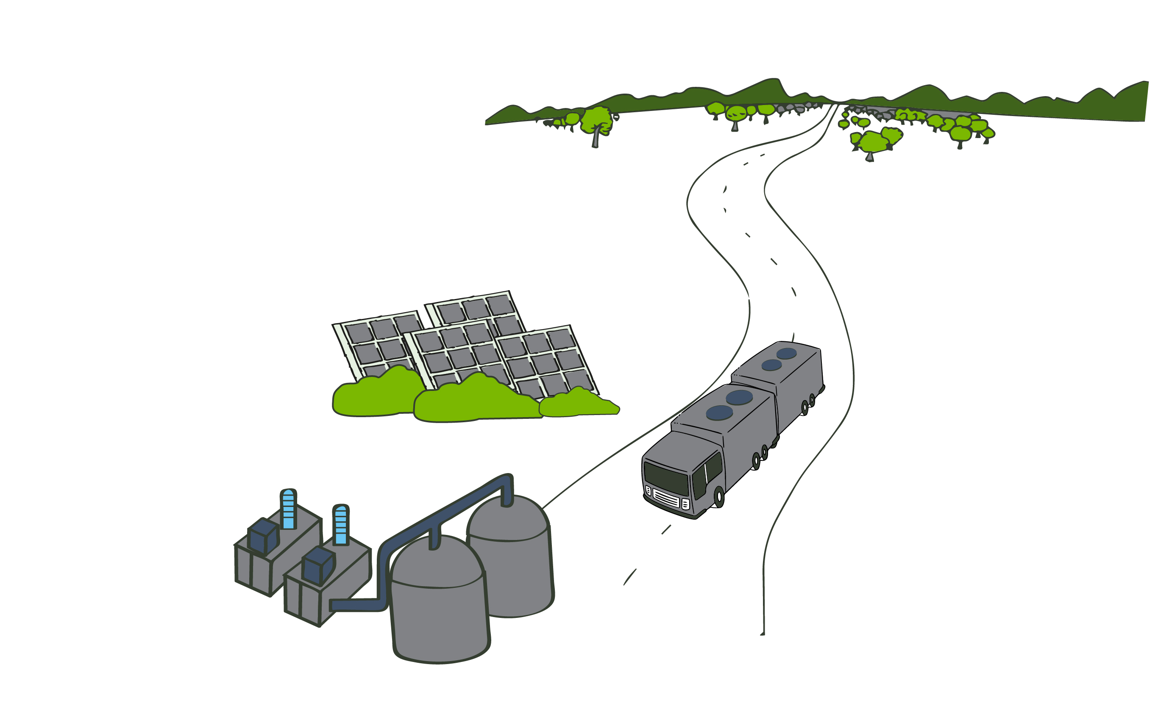
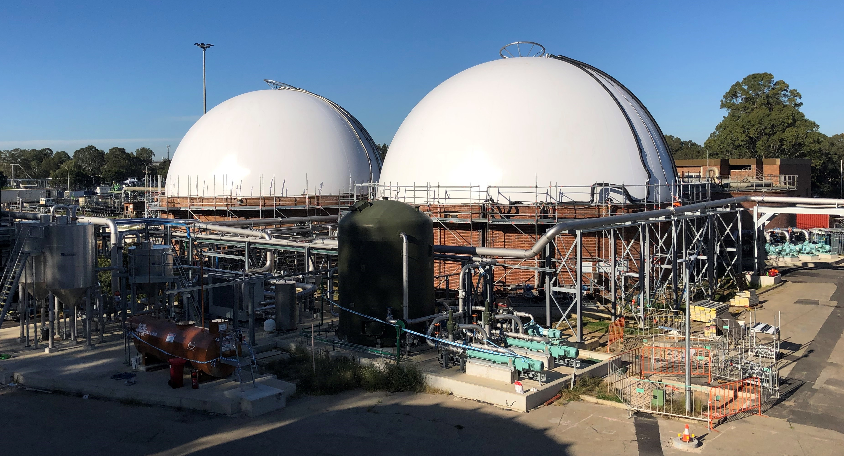
St Marys WRP Biosolid Hub
Key Themes:
Reduced life cycle cost from re-use of existing infrastructure
More sustainable outcome through cogeneration.
Reduced carbon footprint and community impact by taking 200 tonnes of biosolids off the road every week.
Integration of planning, design and delivery.
Forecasted power reduction over 85% from a traditional plant.
Notes:
Firstly I’m going to throw a few key theme statements at you of what we see as the project benefits.
Lower life cycle cost from re-use of existing infrastructure and
a more sustainable outcome through thermal hydrolysis and cogeneration.
Reduced carbon footprint and community impact by taking up to 200 tonnes of biosolids off the road every week.
Forecasted power reduction over 85% from a traditional plant - from 25 GWH/annum to 3 GWH/annum.
So those are some key messages to which I’ll speak through my talk.

Slide 5
St Marys WRP Program Journey
2013
2013 - 2014 Quakers Hill WRP Strategic Options
2017
2020
2023
Options + Concept Design St Marys Dewatering
NWG Servicing Strategy
March 2015 – Lower South Creek Strategy Signed
Lower South Creek Consolidation Study
2015 - 2016 – Quakers Hill and St Marys PARR. Detailed Planning
St Marys BDU Handling Units Detailed Design and Construction
2016 - 2019 – Biosolids Hub Concept And Detailed Design
2017 - 2023 Lower South Creek Construction + Commissioning
Notes:
In todays presentation I’m going to be talking through the Biosolids hub program journey, across a number of treatment plants in the North West growth area, namely Lower South Creek.
Specifically, I’m focussing on the St Marys Biosolids Hub however this is a part of a much bigger program which has evolved over a number of years, through planning, click ….decision on a strategy, detailed planning, concept and detailed design and construction.

Slide 6
Part 1: Why?

Slide 7
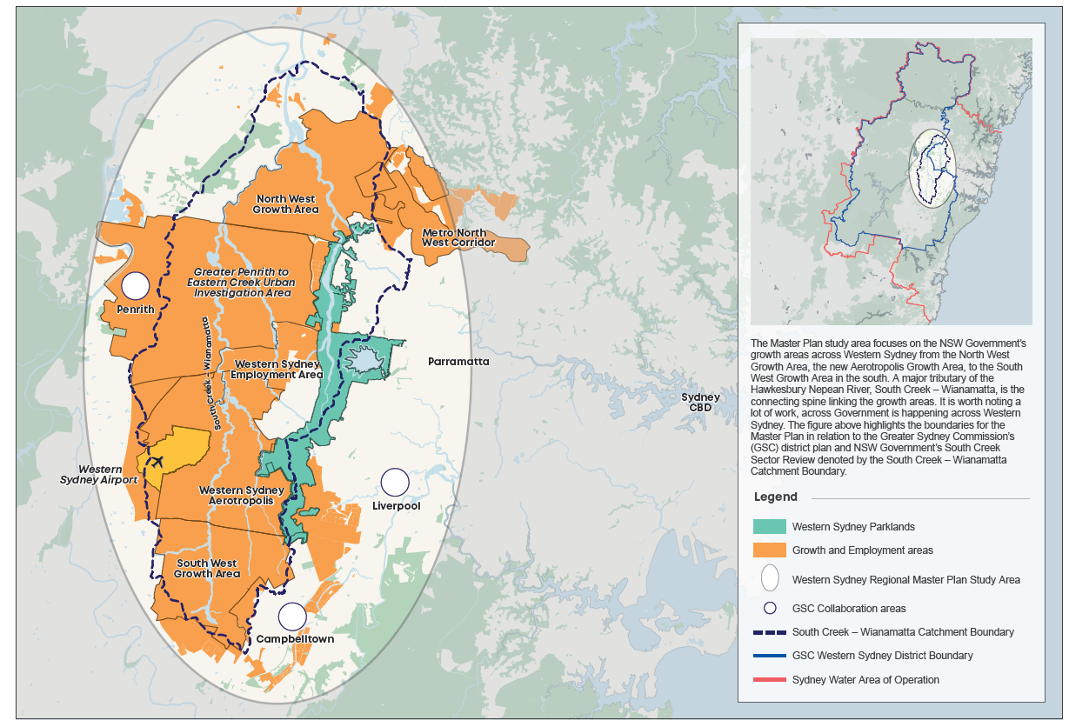

Sydney Water - Western Sydney Regional Master Plan, 2020
St Marys WRP
Quakers Hill WRP
Notes:
To set the context, I’d like to just talk to this image, taken from Sydney Water’s Western Sydney Regional Master Plan.
The biosolids Hub treats the solid streams of the St Marys and Quakers treatment plants, shown in the map. The sites are both within the areas of Sydney experiencing significant growth. And another thing I’ll point out here is that the two plants involved sit in different SW operational regions. This comes with a complexity of getting stakeholders together but it also presents an opportunity.
That opportunity is that the two regions faced the same challenges in a bubble licence into the HawkesNepean system, with very tight Nitrogen and Phosphorous drivers. The project could ask the question how best can we use the resources, location, and opportunities of both sites to jointly service the region?

Slide 8
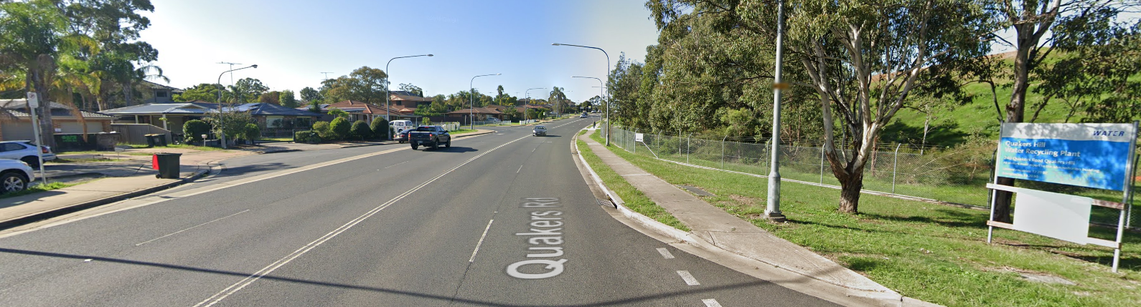
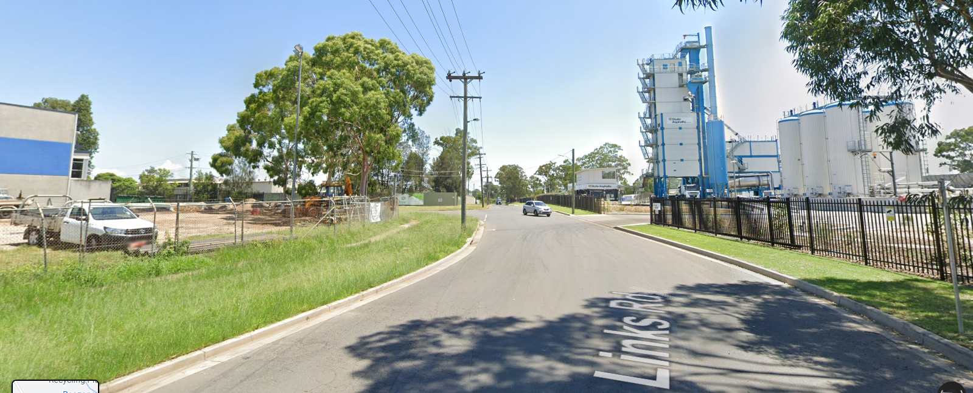
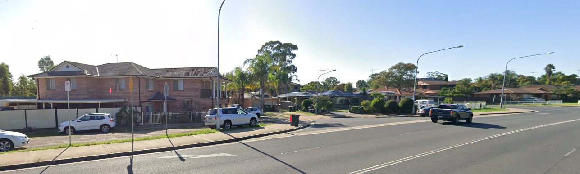
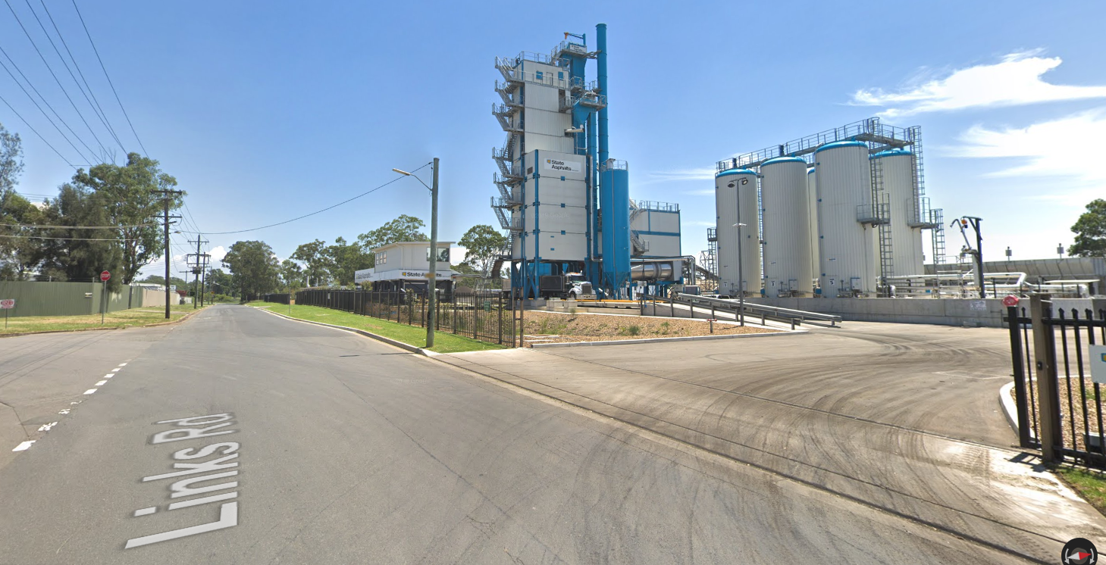
Key Drivers
Growth - 20% to 2043
Asset Performance – namely biosolids quality
Sydney Water Sustainability Strategy
  Efficient and sustainable resource use.
Asset Renewals
Land Use Compatibility
Notes:
That outlines one of the key points behind the program, which is growth. Along with this comes renewals and asset performance, where there was a big focus on the relatively poor quality biosolids produced at the Quakers And St Marys WRP sites. The two plants previously produced grade B biosolids, however the cost of transport per tonne in elevated due to biosolids quality. Sydney Water pay a premium and face a reputational risk based on sludge quality
Strategic goals. With respect to this project, there was a focus here on Energy and carbon emissions, waste management, and water resources security.
So asset renewals drivers really provided an opportunity here. Looking around the LSC hub, the St Marys WRP and Quakers Hill WRP both required upgrades. The IDALs at Quakers Hill were in need of significant structural refurbishment or replacement, and ageing solids handling infrastructure at St Marys, old belt filter presses for dewatering, needed to be upgraded.
The is also an opportunity here is from a customer impact perspective.
Click, this first photo shows the closest neighbours to the Quakers Hill plant, in a more residential area, where St Marys WRP click is in an industrial setting, next door to an ashphalt plant, with really good truck access. This in turn provides the opportunity to consolidate the biosolids of the region in a fit for purpose environment.

Slide 9
Part 2: Planning Approach

Slide 10
St Marys WRP Program Journey
2013
2013 - 2014 Quakers Hill WRP Strategic Options
2015
2017
2019
2021
Options + Concept Design St Marys Dewatering
NWG Servicing Strategy
March 2015 – Lower South Creek Strategy Signed
Lower South Creek Consolidation Study
2015 - 2016 – Quakers Hill and St Marys PARR. Detailed Planning
St Marys BDU Handling Units Detailed Design and Construction
2016 - 2019 – Biosolids Hub Concept And Detailed Design
2017 - 2023 Lower South Creek Construction
Notes:
Coming back to the timeline of this program, you need to first focus on the planning.

Slide 11
St Marys WRP Planning Journey
2013
2013 - 2014 Quakers Hill WRP Strategic Options
2015
2017
2019
2021
Options + Concept Design St Marys Dewatering
NWG Servicing Strategy
March 2015 – Lower South Creek Strategy Signed
Lower South Creek Consolidation Study
2015 - 2016 – Quakers Hill and St Marys PARR. Detailed Planning
St Marys BDU Handling Units Detailed Design and Construction
2016 - 2019 – Biosolids Hub Concept And Detailed Design
2017 - 2023 Lower South Creek Construction
Notes:
Historically a great deal of work had been done on the region. There was the QH WRP strategic options to try and understand the required upgrades to deal with the structural issues at Quakers, the important point here is that this study noted the opportunity to consolidate a solution with St Marys.
At the same time the NWG servicing strategy was happening.
Also, the options were being developed for the upgrade of the aging biosolids handling facility at St Mary.
So a consolidation study was commissioned to bring those elements together

Slide 12
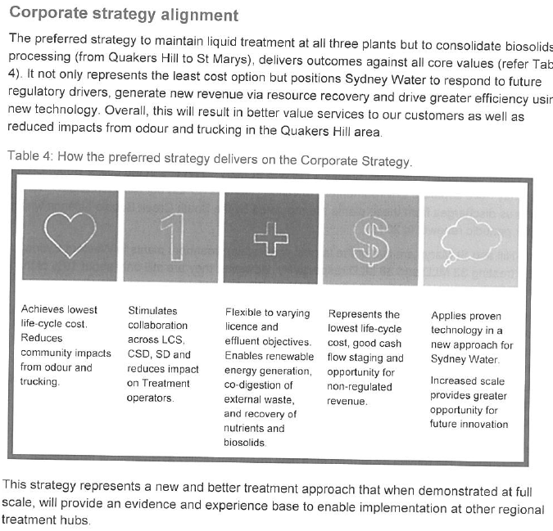
St Marys WRP Strategy Journey
2013
2013 - 2014 Quakers Hill WRP Strategic Options
2015
2017
2019
2021
Options + Concept Design St Marys Dewatering
NWG Servicing Strategy
March 2015 – Lower South Creek Strategy Signed
Lower South Creek Consolidation Study
2015 - 2016 – Quakers Hill and St Marys PARR. Detailed Planning
St Marys BDU Handling Units Detailed Design and Construction
2016 - 2019 – Biosolids Hub Concept And Detailed Design
2017 - 2021 Lower South Creek Construction
Notes:
In 2015 the LSC strategy document was signed. Key to this, was the corporate strategy alignment.
The cut-out on this slide is from the original LSC strategy document which briefed the ongoing delivery of the program. Within that document was the requirement to align with SW corporate sustainability goals and that the plant should:
Enable renewable energy generation.
Allow co-digestion of external waste
Allow recovery of nutrients and biosolids.
So the combination of previous planning work and alignment with the organisations strategic goals was key to setting the ongoing direction of the program.

Slide 13
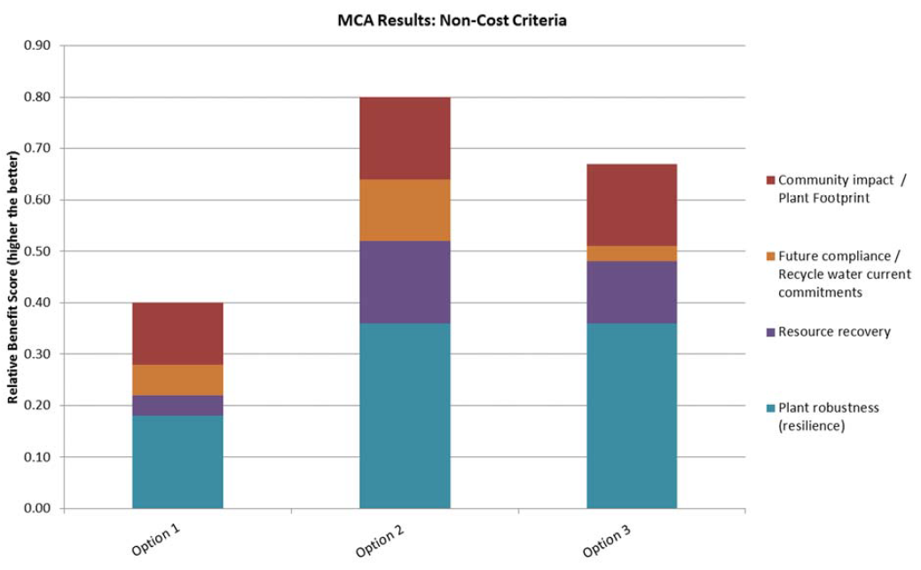
Detailed Planning - Multi-Criteria Analysis
BAU – Two separate plants
Biosolids Hub with Sludge Transfer
Biosolids Hub with Sludge+ Liquid Transfer
Notes:
The project team went into the detailed planning phase to ultimately develop the preferred option to receive waste primary and waste activated sludge from the St Marys site and also import sludge via pipeline from the newly upgraded Quakers Hill WRP. This required an conversion of the existing aerobic digesters at St Marys into anaerobic digesters to allow for energy capture through biogas production
Cost and non-cost planning, illustrated here with the MCA outcomes resulted in the selection of that preferred option, of a regional solids facility at St Marys. Notably the planning found that option to be more robust and have a better resource recovery outcome.
I’d like to point out here that many outcomes of the project, such as the use of a cogeneration, were facilitated through economies of scale in combining the two sites. The combined treatment hub made that investment competitive, compared to having two separate co-generation sites – which ultimately led to that higher resource recovery score in the MCA..

Slide 14
Iterative Planning Methodology
Regional and Strategic (High Level)
Local (Detailed)
Any changes?
Overall Scheme options selection – MCA workshop
Quakers Hill WRP Liquid stream options design – MCA workshop
St Marys WRP solid stream options design – MCA workshop
Preferred Option for Concept Design
Any changes?
Notes:
The project methodology was based around integrated system planning. The planning process required integration of multiple packages of work to minimise the risk of designing incompatible processes. We’re looking at two sites here so a key focus had to be compatibility between liquid stream upgrades selected at Quakers Hill, the sludge pipeline transfer and design of solids receival and treatment at St Marys.
The project methodology required a balance of both planning and engineering detail. There was an iterative approach between strategic planning and concept feasibility. The regional scheme level options were developed and chosen, and then plant level details for each site were developed. The plant level solution were then taken back into the lens of the regional planning decisions to confirm we’re still on the right track without fatal flaws.
An example of this is that centrate nutrient loads from the full regional biosolid facility would cause the liquid stream at St Marys to fall over – how do those loads get managed, do you need a bigger liquid stream at St Marys?

Slide 15
Part 3: Design

Slide 16
St Marys WRP Design Journey
2013
2013 - 2014 Quakers Hill WRP Strategic Options
2015
2017
2019
2021
Options + Concept Design St Marys Dewatering
NWG Servicing Strategy
March 2015 – Lower South Creek Strategy Signed
Lower South Creek Consolidation Study
2015 - 2016 – Quakers Hill and St Marys PARR. Detailed Planning
St Marys BDU Handling Units Detailed Design and Construction
2016 - 2019 – Biosolids Hub Concept And Detailed Design
2017 - 2023 Lower South Creek Construction
Notes:
No we turned our attention to the design.

Slide 17
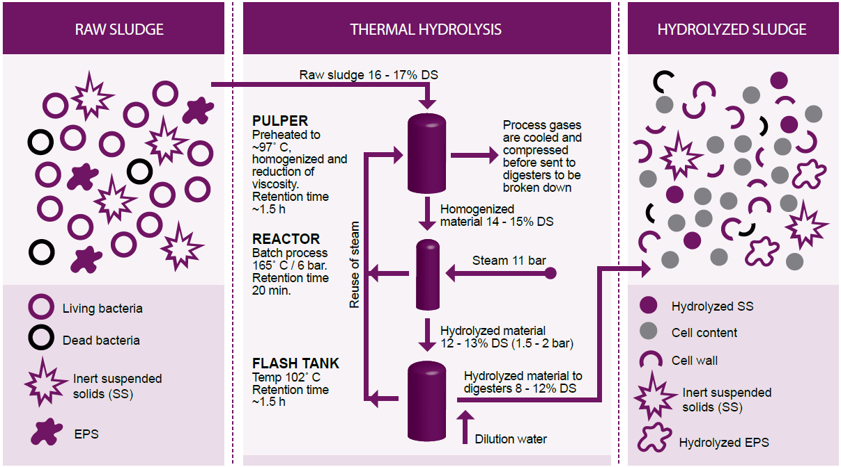
MAD + Thermal Hydrolysis
Uses high temperature and pressure to breakdown slowly biodegradable cellular material to increase volatile solids conversion.
Key Benefits over traditional digestion
Better Volatile Solids Reduction – less Biosolid mass
Lower Viscosity = Higher digester conc = lower digester volume = no new digesters!
Drier cake - 4% increase
Key Risks
Impact of side streams
Colour – especially feeding the St Mary AWTP – MF/RO
Higher complexity
CAMBI® Skid
Mixed Sludge
Pre-Dewatering
Digestion
Dewatering
Notes:
We can’t talk about the plant without discussing thermal hydrolysis process train. THP was selected in the detailed option phase as a preferred technology. Which I’ll talk through the concept very briefly here, apologies there are many out there much better versed in the technology than me.
The idea is that thermal hydrolysis can shortcut the hydrolysis step in the digesters, and pre-treat the sludge in two main steps. Firstly via pressure cooking (at around 160 degrees and 6 atmospheres). And then via rapid depressurisation or flashing, the best analogy is pressure cooking and blending your food before you eat it. This means:
Cellular material - specifically waste activated sludge or secondary sludge, is made more bioavailable.
The sludge is easier to digest and gets a higher VSR
The sludge is less viscous so you run a digester at a higher concentration, effectively cramming more stuff into the same volume. This benefit is really key here. The THP process meant that the biosolids hub could treat the loads of the whole region, without the need to build any new digesters in the form of enormous concrete tanks. With conventional digestion would have needed around 6 digesters, whereas with THP you can operate with three.
The final sludge product is easier to dewater in a centrifuge – so you get a drier cake, and hence you’re carting a drier product. The planning estimated that the combination of improved VSR and dewaterability accounted for about 35% or 30 tonnes a day of trucked biosolids reduction.
With THP there are risks, including
The impact of side streams on the liquid stream performance.
The high temperatures are known to create a recalcitrant colour through the maillard reaction. St Marys feeds an AWTP, where the impacts of this colour are largely unknown.
The higher complexity of the plant is a risk from an operational perspective.

Slide 18
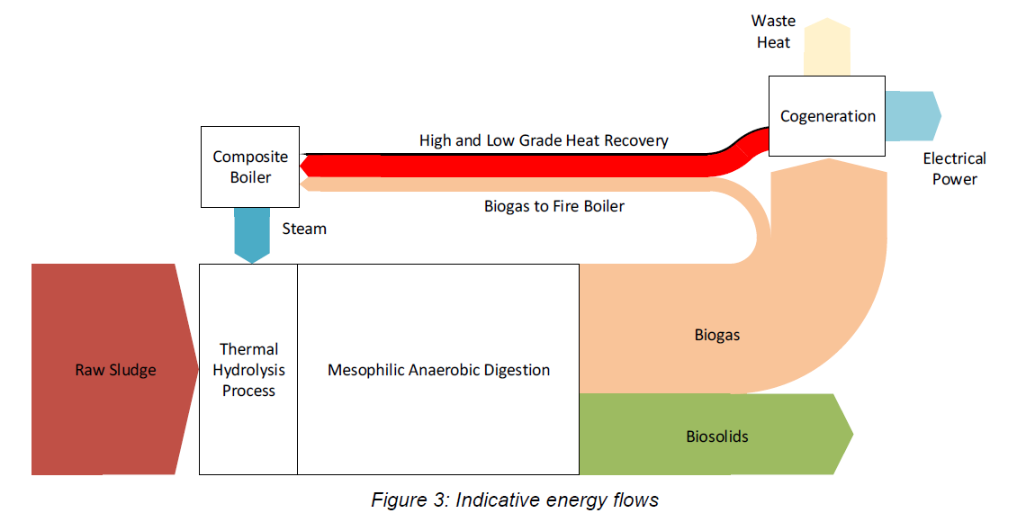
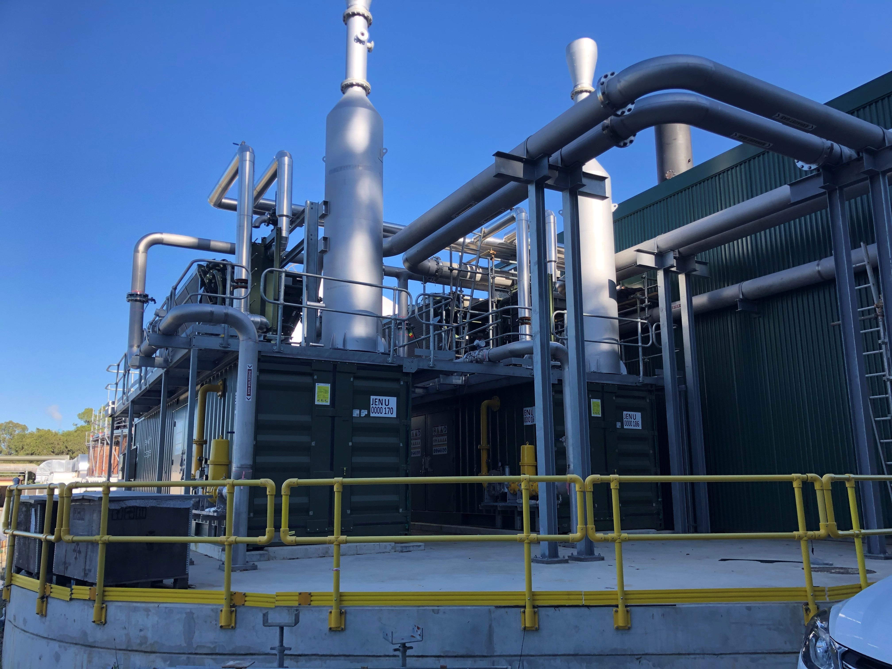
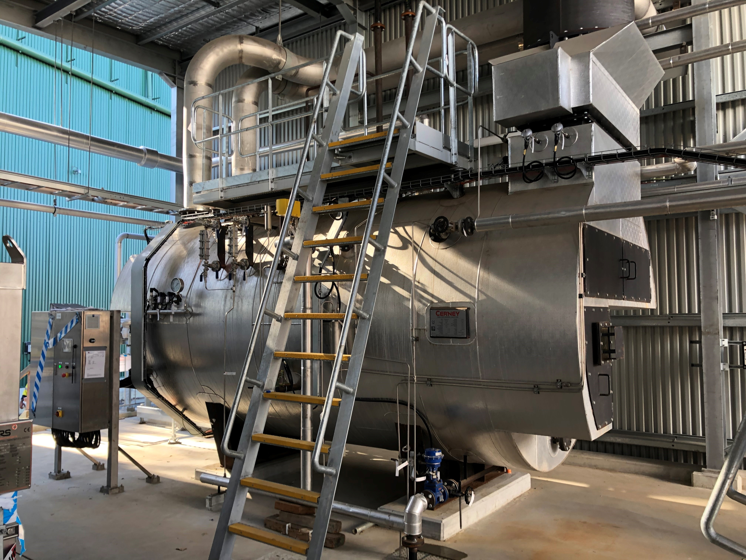
Capturing Energy Flows
Composite Boiler
Co-generation Engines
Thermal Hydrolysis and Anaerobic Digestion
Notes:
Key to the planning and design process was understanding energy flows. Now this is a simplified version of an energy flow balance which grew in detail with the design but it shows the key points.
As a system, the intent was to recover as much carbon based energy as possible. The detail here is that:
Biogas in traditional AD can be used for heating or flared.
Co-generation was added, that produces electrical power and recoverable waste heat.
Recoverable heat is in the form of
High grade heat from the exhaust - feeding the composite boiler
Low grade heat in the form of co-generation engine jacketed heat recovery to pre-heat the BFW.
Some biogas may be required to assist the boiler during certain load and temperature conditions.
Now this is obviously a simplification of the overall system, but it highlights the type of design thinking that allowed the technical solution of energy recovery to be developed.

Slide 19
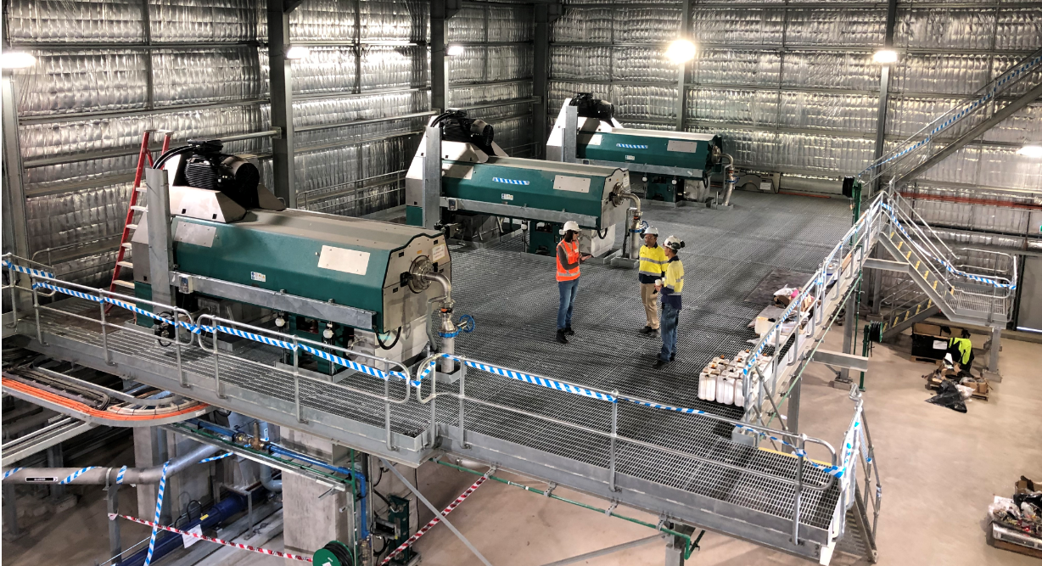
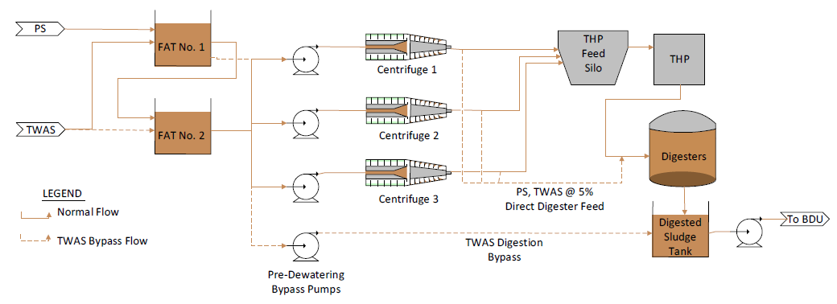
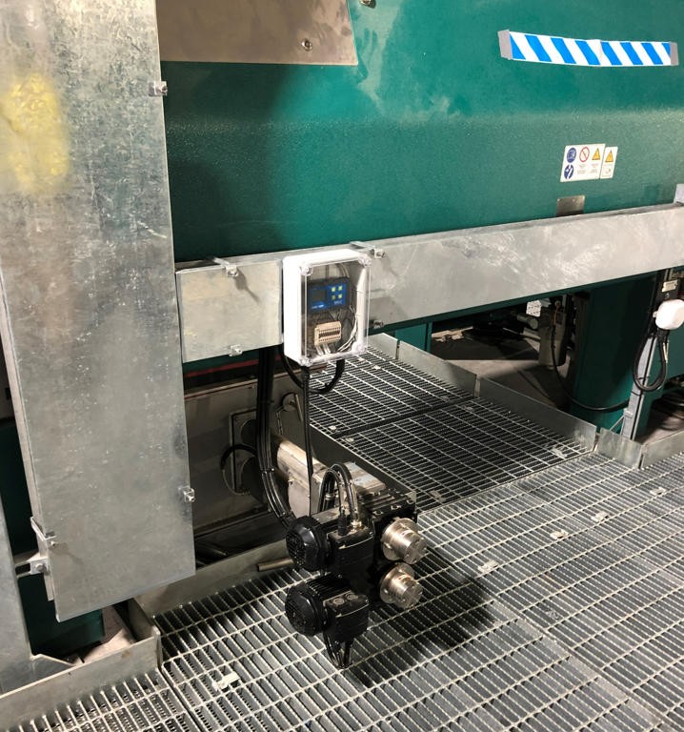
Concept and Detailed Design
Sludge Sample Instrument
Notes:
I mentioned the higher complexity of the plant is a risk from an operational perspective. How do you make the more complex plant as stable as a traditional fill and spill digester process.
Some of the solution to that problem was around the pre-treatment:
a new sludge receival, balancing and centrifuge pre-dewatering train to prep sludge for THP and digestion
A further issue was around sludge feed to the centrifuge process. CAMBI requires sludge to be fed at 16.5% dry solids – essentially a stream of toothpaste. More to the point, it needs to be fairly consistent - to +/- 1.5%DS.. Now that’s difficult to control, especially when you’ve got a mixed sludge feed. The selected system is a varipond unit with a feedback control from a live sludge sampling instrument in the centrifuge outlet. Along with that - a lot of effort went into the design of the pre-dewatering FAT to allow optimal mixing of the sludge streams. In the end this use a strategy of six hours of storage made up of two tanks in series, to try and maintain the most consistent dewatering feed possible given the diurnal variation.
That sludge was then fed to a 500 cube storage silo as a wide point upstream of CAMBI.
The photos here show the centrifuges and in theg second photo you can see this sampling instrument which collects a falling sample of the centrifuge cake in the discharge chute, transfers it via an auger and analyses it and then augers it back into the chute.

Slide 20
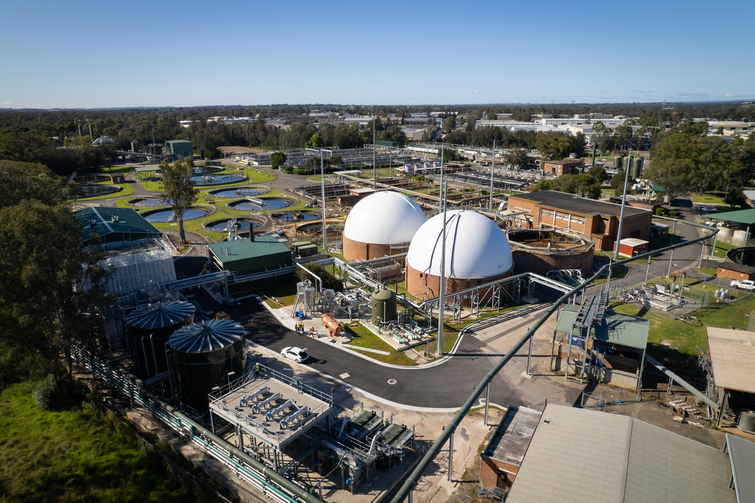
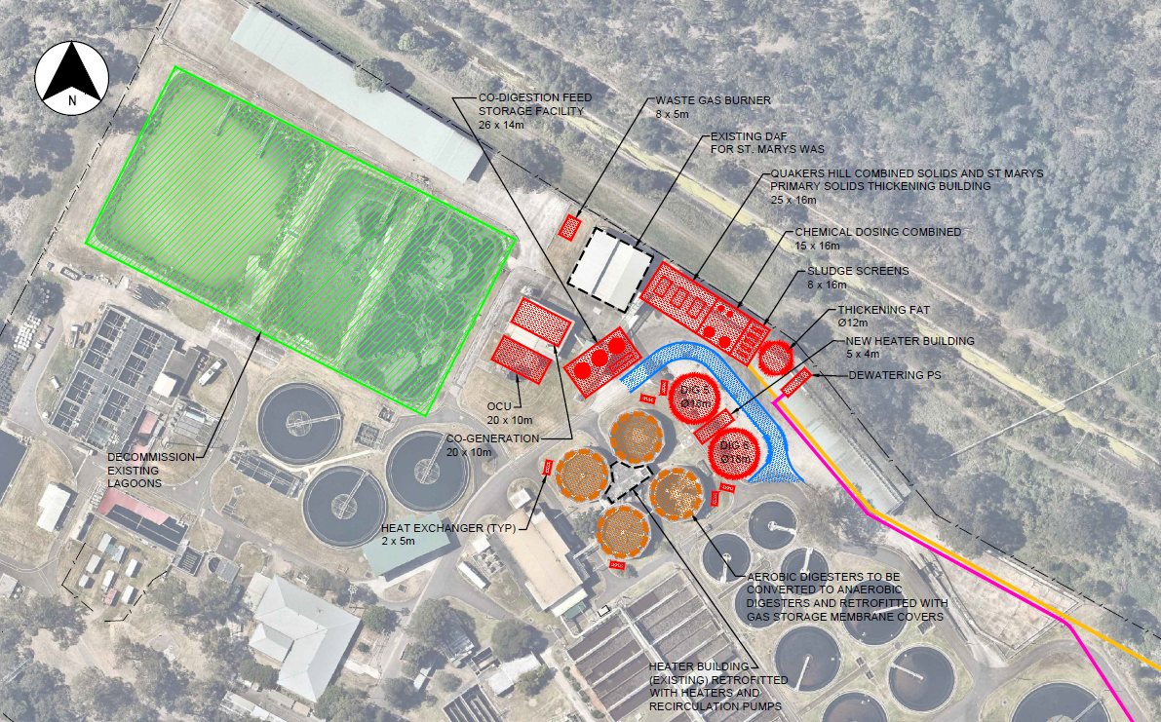
Concept and Detailed Design
Notes:
All those elements come together in taking the project from detailed planning to detailed design. click The image here is the final 3D model, with the sludge handling to the top and right, along the northern boundary and the converted digesters and cogeneration units to the south on the bottom left.

Slide 21
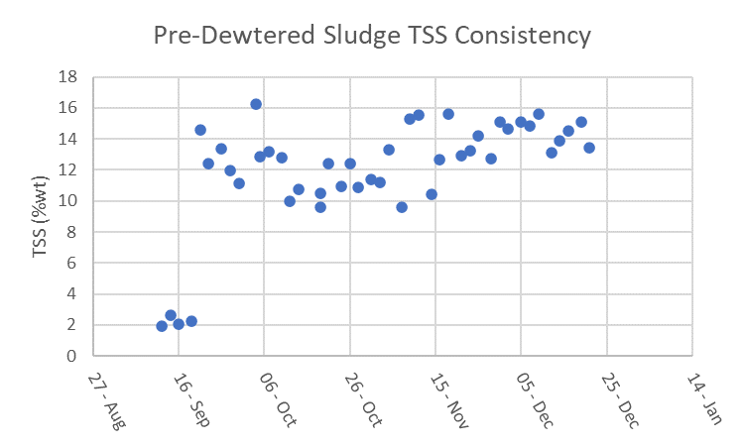
Commissioning Results
Notes:
In terms of some commissioning results, again just to talk to the point of the +/-1.5% requirement, as of December last year, the system was showing very promising results in its ability with the NFR results coming in to a and around 2%DS. Apologies for my very unscientific data analysis dotted lines on there!

Slide 22
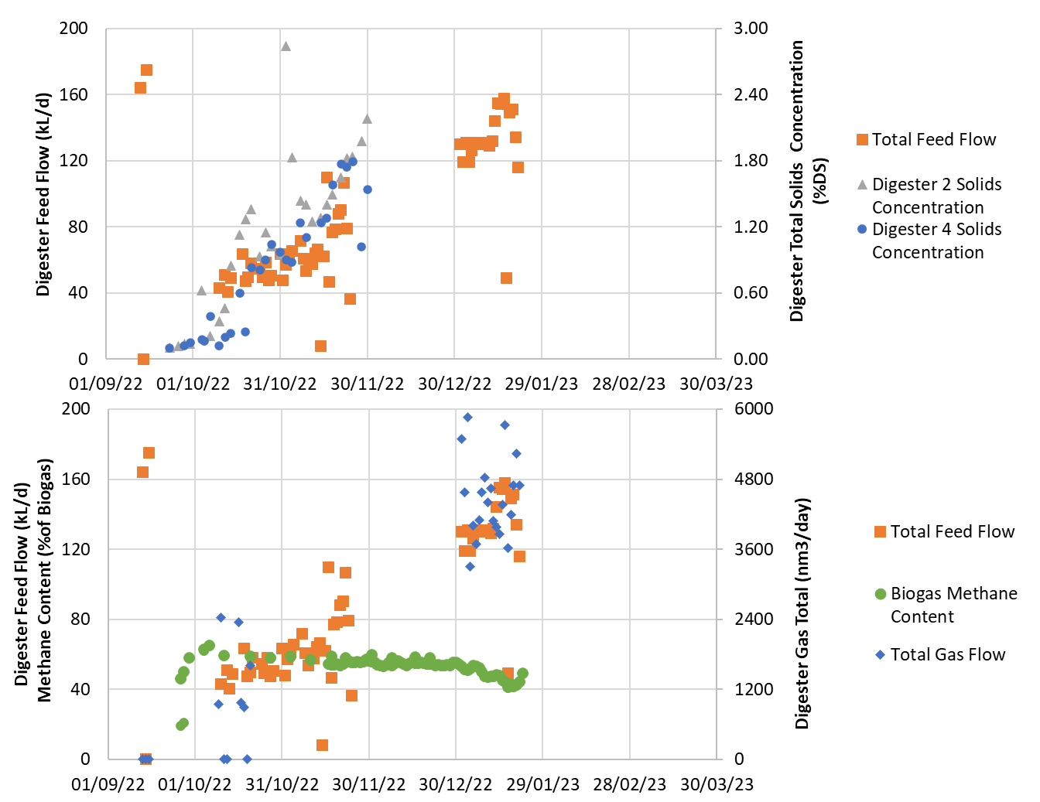
Commissioning Results
Digester concentration up to approximately 2.4%DS in January 23.
Biogas production within approximately 2 weeks of seeding
Challenges in gas handling to overcome – interconnected gas storages.
Challenges in commissioning link to challenges in program due to the interconnectedness of the overall system.
Notes:
Add some information here.

Slide 23
Part 4: Lessons Learned
Notes:
I’m going to talk through a few key lessons learned – at least from a technical perspective, which we can take into account in planning future facilities.

Slide 24
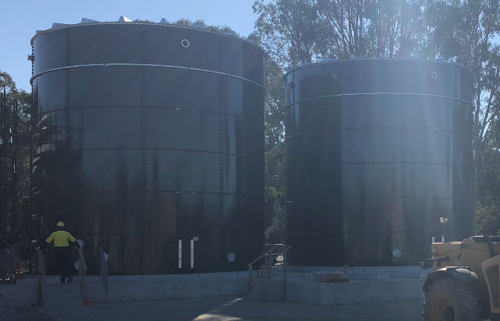
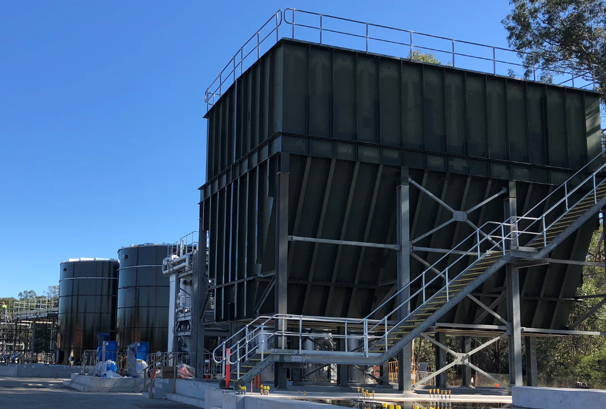
The devil is in the detail
Redundancy
This biosolids factory can’t slow production – feed is treated or stored
Learnings from Urban Utilities, Thames Water essential.
This is informing current planning in understanding allowances for redundancy.
Notes:
The key examples I’ll point to here is redundancy, acknowledging that this biosolids factory has a key artery. It can’t be slowed down. Feed biosolids from the treatment plant need to be treated or stored until such time as they can be treated. There is no other option.
However, the more complex the equipment, the greater the need for redundancy, for example the CAMBI plant itself needs to be shut down for a 5 day annual maintenance.
So first of all, storage is hard as there aren’t many widepoints. Click. Coming back to the PFD, there is the FAT and the THP feed silo.
Upstream, WAS can potentially be held up for a number of days, but it isn’t long until you need to waste. Primary sludge can’t really be held for a meaningful amount of time.
CAMBI worked with us on this to understand what the options are. Primarily, there is an option to feed the primary sludge into the digester for a period of time which equates to about 20% of the digester volume – giving the operator between 3-5 days). Click So the design of the balance tanks was required to allow primary sludge to be handled separately to WAS in this situation.
Click Then there is the feed silo. This silo is 500 cubic metres and allows for an additional 2 days of feed material to be held upstream of the CAMBI plant.
The design developed here really had to focus on a number of strategies to give that flexibility for sludge handling. A key point being that it ultimately adds complexity.

Slide 25
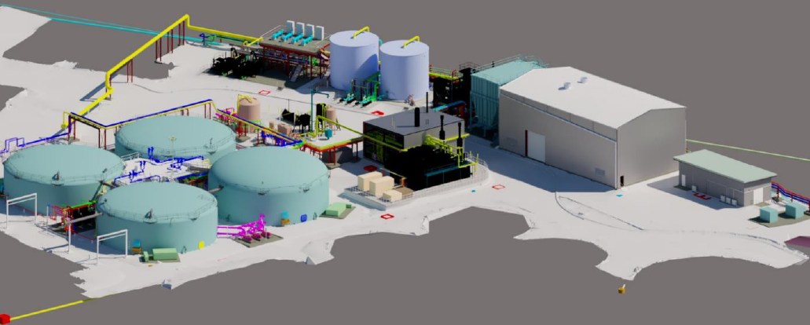
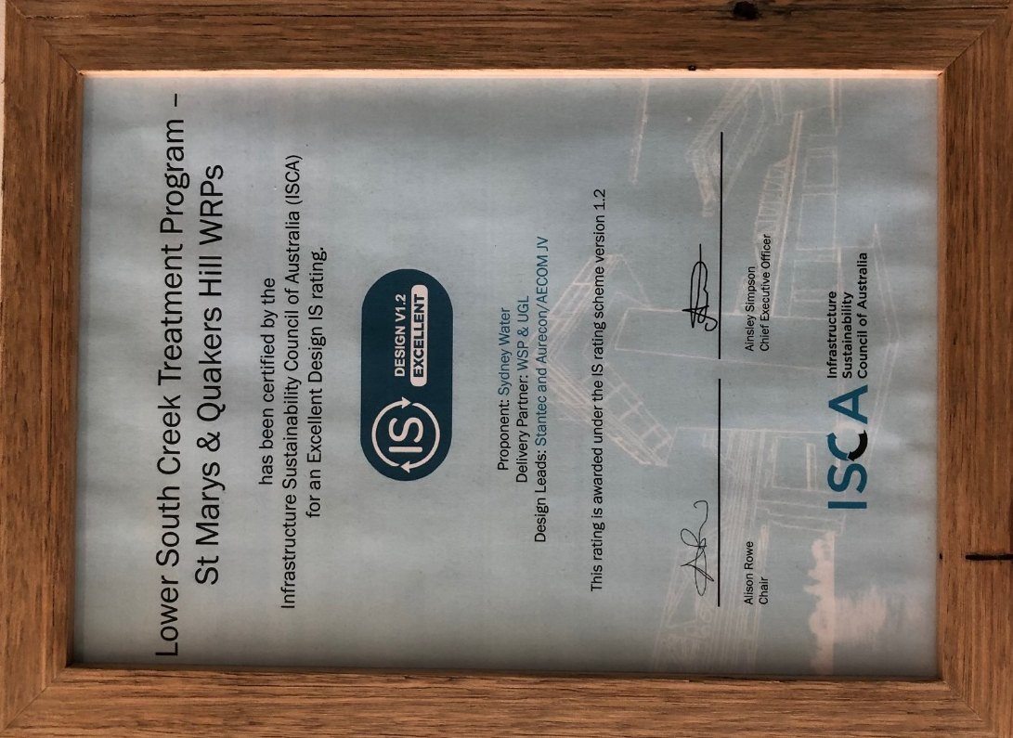
Key Successes
Re-use of infrastructure, integrated with THP and heat recovery technology.
Reduced transport of biosolids by 200 tonnes per week.
Consistent project team has been maintained through strategic planning to detailed design and delivery.
Utilising anaerobic digestion and cogeneration technology - 1.6MW of installed power.
The design ISCA sustainability design rating of ‘Excellent’ as prepared by the LSCTP delivery partner of WSP and UGL.
Forecast Power Demand Reduction from 25 GWH/yr to 3 GWH/yr.
Notes:
I’ll summarise by running through some key benefits.
Re-use of infrastructure, integrated with THP and heat recovery technology.
Reduced transport of biosolids by 200 tonnes per week.
Consistent project team has been maintained through strategic planning to detailed design and delivery.
Utilising anaerobic digestion and cogeneration technology - 1.6MW of installed power.
The project provides a sustainable approach to developing the growing northwest region. The project delivery partner of WSP and UGL prepared the submission for the infra sustainability council of Australia which achieved a rating of excellent, as I understand it, the first wastewater facility to achieve that rating. This sets a precedent for the North West and South West priority growth regions for which Sydney Water is rapidly positioning. The key output of that sustainability rating effort to point to here is the forecast energy savings from 25 for the BAU case to 3 within the LSC program.

Slide 26
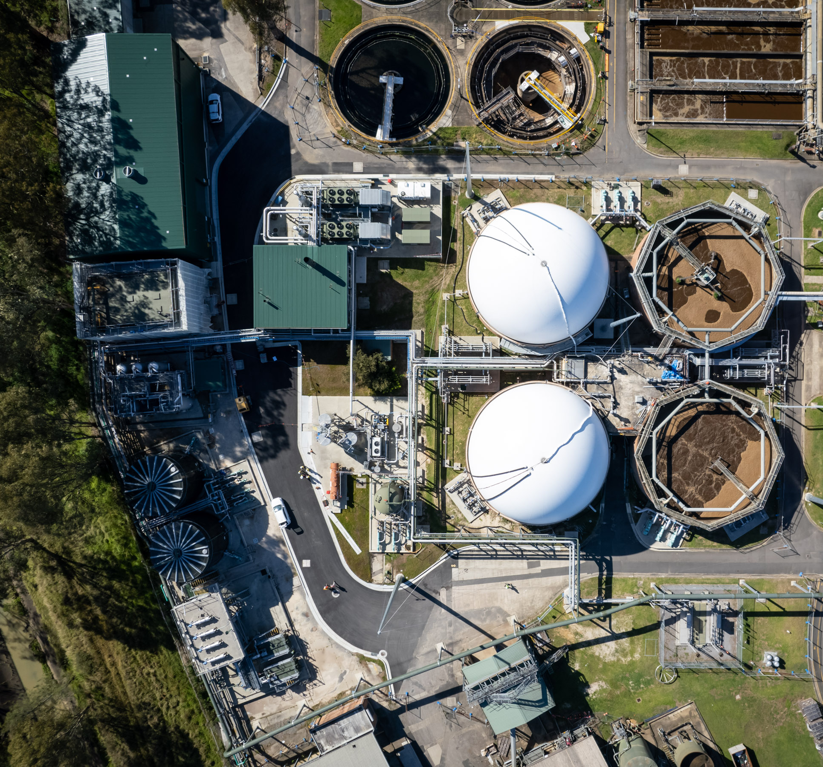
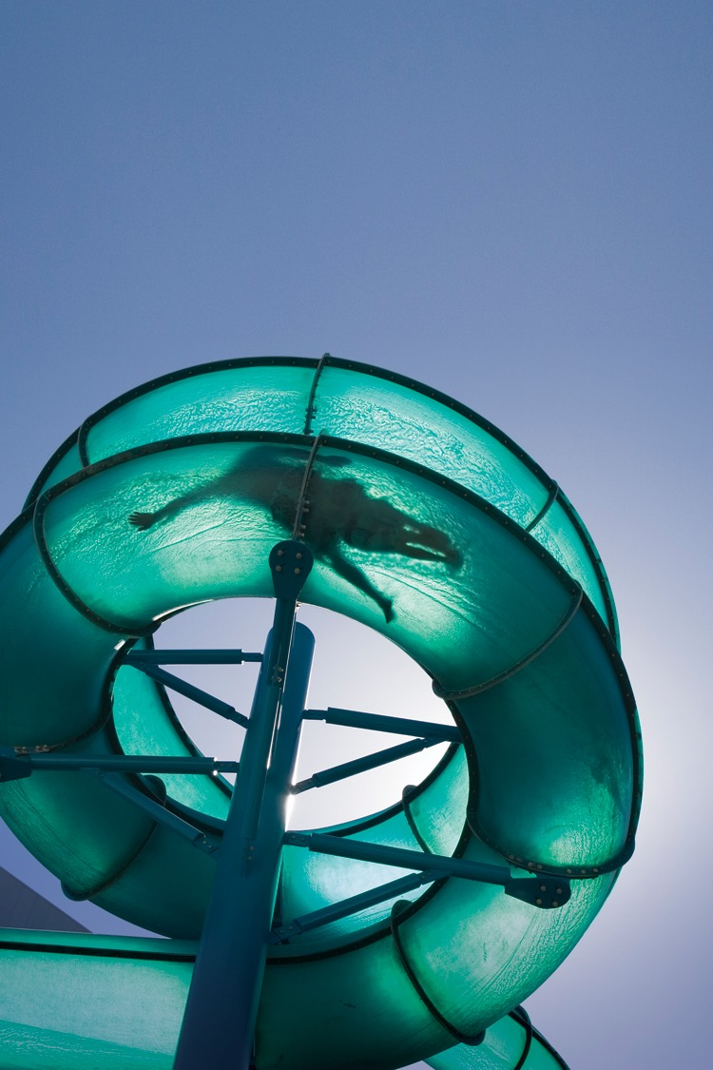
Thanks!
Angus Wilkie
angus.wilkie@aurecongroup.com
Now to Dr Barber!

