Slide 1
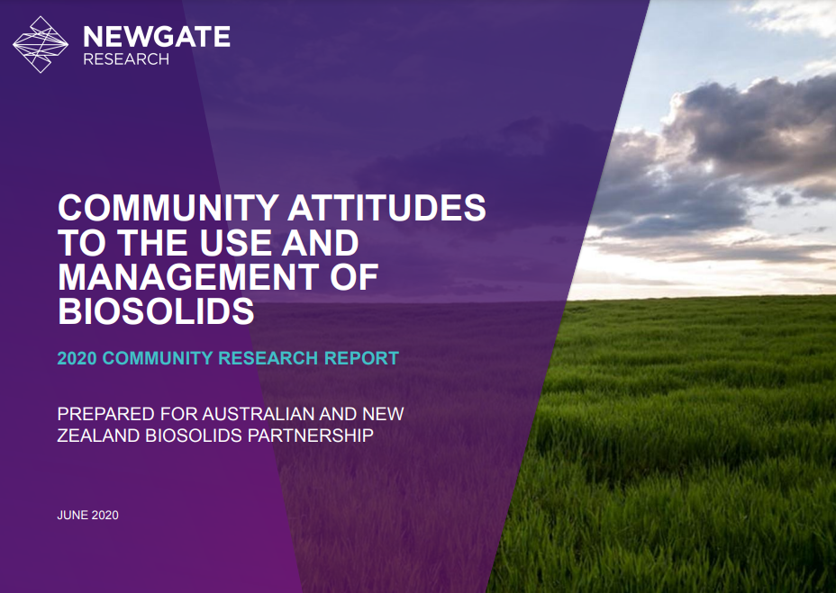
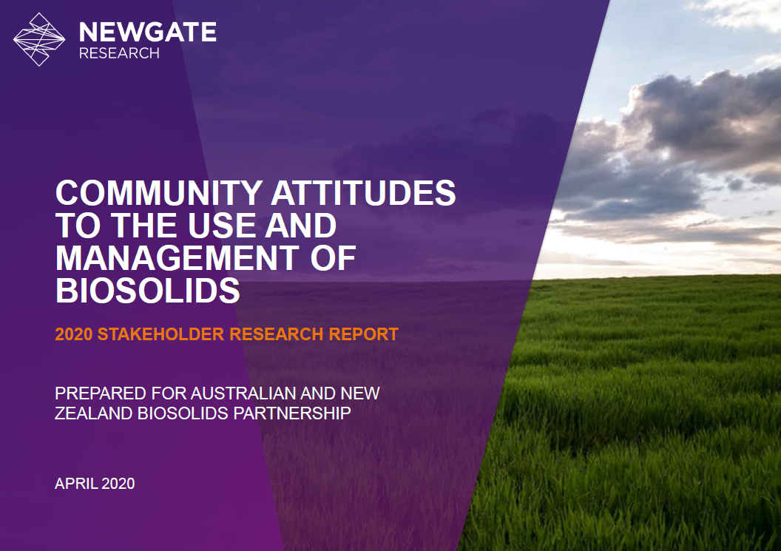
ANZBP COMMUNITY ATTITUDES TO BIOSOLIDS SURVEY 2020
8 FEBRUARY 2023

Slide 2
Acknowledgement of Country
ANZBP acknowledges the Gadigal peoples of the Eora nation on which we gather today. We recognise and respect the cultural heritage, beliefs and continuing connection to the lands and waters of our Traditional Custodians and pay respect to their Elders past, present and emerging.
Indigenous Australians are more likely to be aware of biosolids and feel positive about biosolids use in their local area than non-Indigenous Australians (Community Attitudes to the Use and Management of Biosolids, ANZBP / Newgate Research, 2020).

Slide 3
Outline
Study objectives
Approach and methodology
Stakeholder survey
Community survey
Outcomes
Find survey reports at ANZBP website:
www.biosolids.com.au
Notes:
The Community Attitudes to Biosolids survey reports are available on the ANZBP members site.
We ask that members do not distribute them outside of their member organisation without express permission from ANZBP.

Slide 4
Study objectives
Awareness and knowledge
Attitudes towards biosolids use:
factors influencing community views
key issues to address
most trusted information sources
Engagement strategies and communication materials
Risk management
Changes over time (2010 vs 2020)
Notes:
ANZBP’s mission: support sustainable biosolids management in Australia and New Zealand.
An important element of ANZBP’s role is the development of communication tools that members can use to present factual, unbiased information about the use of biosolids to communities that might have contact with biosolids treatment, transport, use or disposal in some way.
ANZBP has undertaken this project to understand awareness and knowledge of biosolids in the community and understand the attitudes of biosolids stakeholders and the wider community regarding biosolids use and management in Australia and New Zealand.
This includes identifying the key factors that most influence community views, the key issues to address with different audiences and the information sources they would trust the most for information on biosolids.
The purpose was to support the development of engagement strategies and communication materials to address knowledge gaps and provide objective and factual information on biosolids based on the issues of most concern to the community.
The results will also enable ANZBP and its members to manage risk more effectively.
First conducted in 2010, and repeated in 2019/20, allowing us to explore how knowledge and attitudes have changed over the ten years between the 2 surveys.

Slide 5
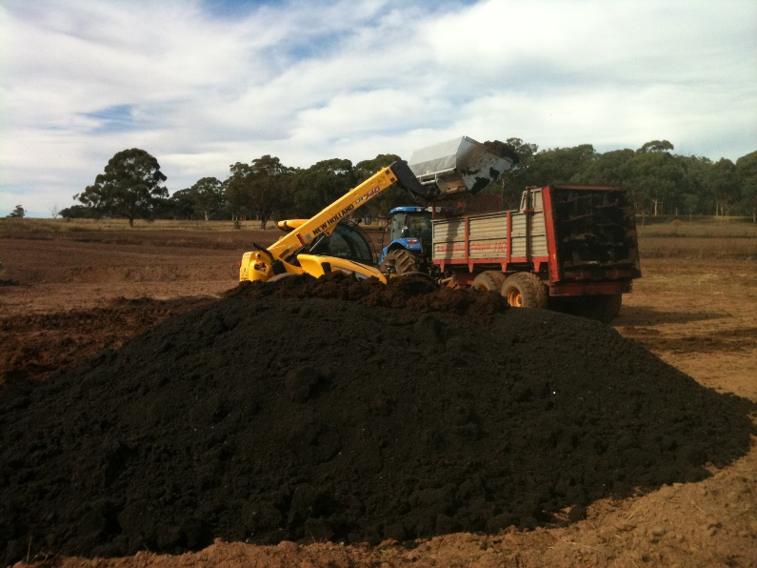
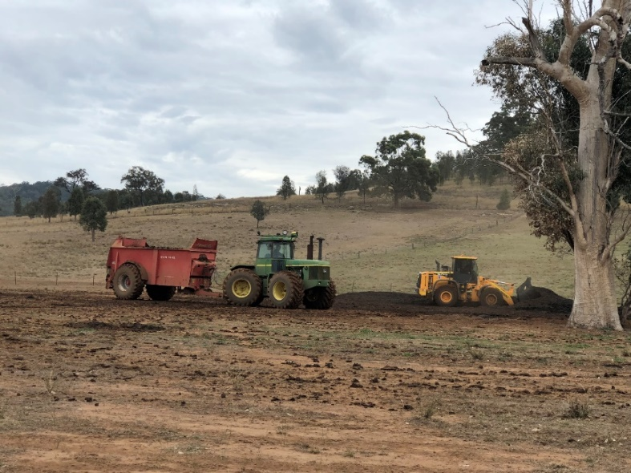
Approach and methodology
Stakeholder interviews (Feb – Mar 2020)
37 x 30-45 minute interviews (mix of phone and in-person)
Wide range of stakeholder groups
Stakeholder views and opinions on biosolids and the ANZBP
Stakeholders needs
Qualitative
Pre- Covid pandemic
Biosolids being loaded for spreading on agricultural land
Notes:
Stakeholder Interviews (Dec 2019 to Feb 2020):
37 interviews with a cross-section of stakeholder groups who are responsible for processing, using, advising on, regulating and conducting research into biosolids, to understand their views and opinions on biosolids and the ANZBP, and their needs in relation to biosolids. Note this was conducted before the covid- pandemic so we don’t really know how views might have changes as a result of the pandemic.

Slide 6
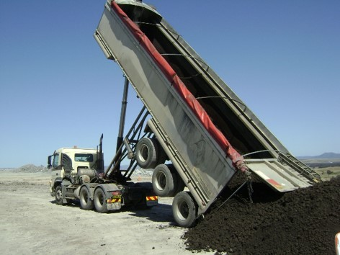
Approach and methodology
Community survey (May 2020 – Jun 2020)
15-minute online survey
20-minute computer aided telephone interview (CATI) survey
Sample size n=1225 participants (n=1,029 in Australia; n=226 in NZ).
Quotas: location, age, gender, proximity
Quantitative
During Covid pandemic
Biosolids being delivered for mine rehabilitation
Notes:
Community Survey (May to Jun 2020):
15-minute online survey and a 20-minute computer aided telephone interview (CATI) survey with a sample of n=1200 participants from Australia and NZ.
Quotas were set on location, age and gender to represent a broad cross-section of opinion in line with key population statistics in each country.
Additional quotas were set to achieve a mix of people living close to areas where biosolids are being produced and potentially used (Neighbours), and those who do not (General Community).
The sample size of n=1,225 means that the overall results contained within this survey have a margin of error of +/-2.8% at the 95% confidence level. A margin of error tells you by how many percentage points your results may differ from the real population value. For example, a 95% confidence interval with a 2 percent margin of error means that your statistic will be within 2 percentage points of the real population value 95% of the time.

Slide 7
Stakeholder survey results
Notes:
As part of the stakeholder survey we mapped the knowledge of biosolids for a wide range of stakeholders.
Knowledge about biosolids is largely accumulated ‘on the job’ and so is highly dependent on the role the stakeholders have. This means that knowledge levels vary greatly across the sample.
Intermediaries (e.g. transport, composting, organics recyclers)

Slide 8
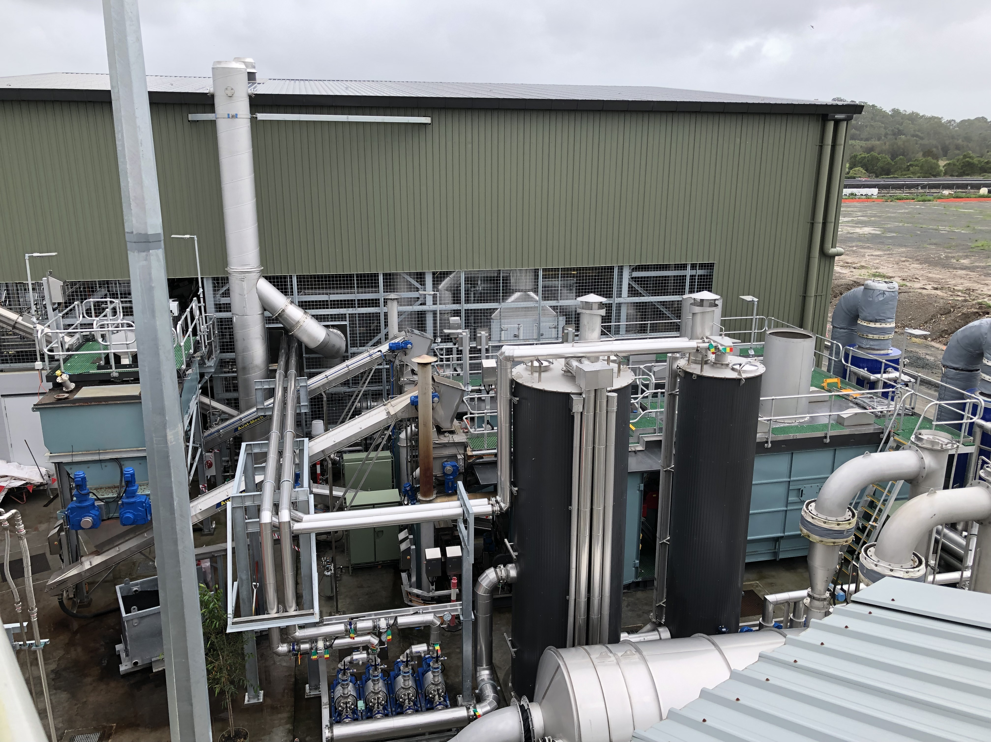
Stakeholder survey results
Awareness of biosolids uses and benefits
Concerns about emerging contaminants
Composting and energy recovery
Investment drivers
New technologies
Loganholme WWTW biosolids gasification plant
Notes:
Among the stakeholders interviewed, perceptions of biosolids are generally positive.
Stakeholders are fairly aware of the benefits of biosolids, both in terms of specific product characteristics and as a good example of beneficial reuse of waste.
However, stakeholders have concerns about emerging contaminants (in particular, PFAS and microplastics) and some perceive regulators as slow to act in providing clear guidance on safe levels and implications for handling and application.
This was similar to 2010 results but more pronounced, with feedback from stakeholders about increased stockpiling and patchy availability of biosolids, and discussion around composting and biosolids for energy generation, including co-digestion with food waste.
Stakeholders noted that scalability and required investment have limited growth in energy recovery from biosolids, but there is a general sense that decreasing land availability and increasing biosolids production will drive more investment moving forward
There is also greater interest in new technologies compared to the 2010 survey, with increasing technologies trials in recent years.

Slide 9
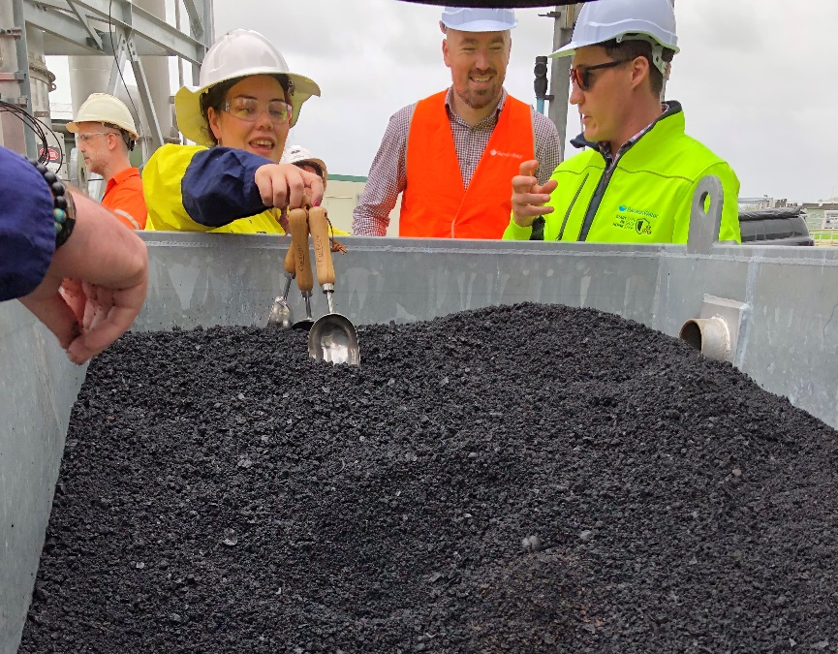
Stakeholder survey recommendations
Build confidence around emerging contaminants
Build awareness of benefits and case studies
Invest in source control
Support market development and diversification
Loganholme WWTW biochar product
Notes:
Build industry and end user confidence around levels and handling of emerging contaminants
Build awareness of biosolids benefits and case studies
Invest in community education and trade waste customer engagement to improve biosolids inputs (source control)
Support market development for land application and market diversification to “future-proof” the biosolids industry

Slide 10
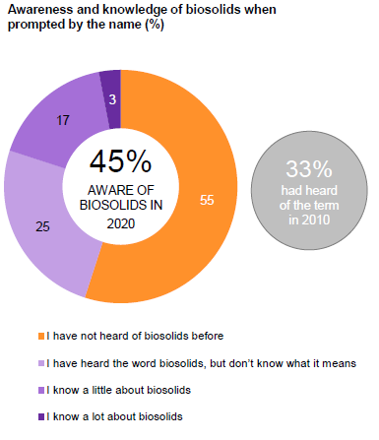
Community survey results – awareness and knowledge
Reasonable awareness
Some knowledge
Feeling un-informed
Unsure about feelings
Low negativity
Notes:
There is fairly good awareness of the term ‘biosolids’: 45% have heard the term before – this is up from 33% in 2010.
There is reasonable knowledge of biosolids: 37% of participants were able to describe some aspect of what biosolids are when prompted only with the name.
However, only 3% of participants felt they know a lot about biosolids and 20% have a little knowledge.
As might be expected when people feel un-informed, many participants were initially unsure how they felt about biosolids: Almost 60% felt neither positive nor negative towards biosolids being used in their country or in their local area.
But most people were not against the idea: <8% felt negative about biosolids being used in their country or their local area and one-third felt positive to some extent.
Opinion was more polarized in NZ, where people in proximity to biosolids treatment and reuse locations felt more positive than the general community.

Slide 11
Community survey results – impact of information on sentiment
Positivity doubles given a brief description
Information is good!
People care about reducing pollution and recycling waste
Lack of information; uncertainty over long-term impacts
Preference for natural vs. chemical fertilisers; waste recycling; soil benefits.
Notes:
The study explored how sentiment about biosolids shifts when people are given more information.
We found that positive sentiment towards biosolids doubles when people are shown a brief description of biosolids (from 36% up to 73%), while the proportion who are negative remains at a similar level.
In other words, providing information is a good thing.
We also observed that biosolids reuse aligns with issues people are concerned about, such as reducing pollution and recycling waste.
Those who felt positive about biosolids give reasons such as:
Biosolids are natural and therefore better than chemical fertilisers;
Biosolids are a good way to reuse waste; and
Biosolids are good for the soil.
Those who felt negative or unsure about biosolids give reasons such as:
I don’t have enough information to make a decision; and
I don’t know what the long-term health and environmental impacts are.
Anyone who has been involved in community engagement projects would probably agree that this is not really unexpected.

Slide 12
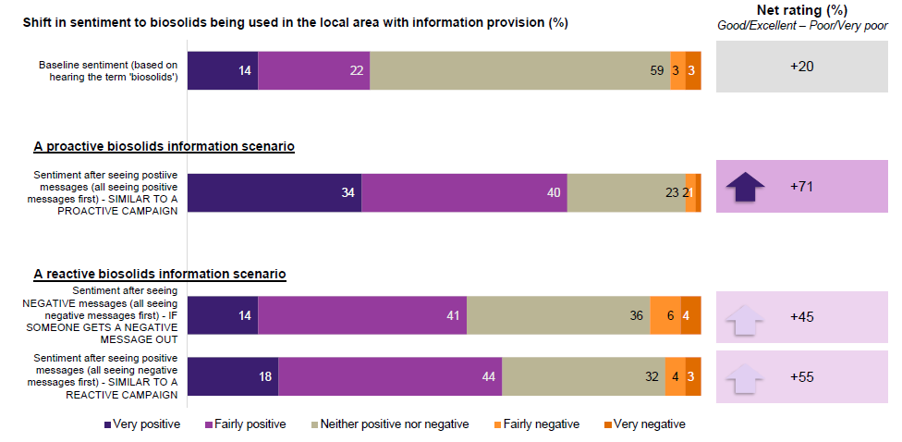
Community survey results – impact of messaging on sentiment
+30
Proactive beats reactive!
But even reactive beats silence...
Notes:
The study examined how public opinion shifted when exposed to messages for and against the use of biosolids in their local area. Data modelling was used to identify the messages that had the greatest impact on people’s perceptions about biosolids, so these can be considered as priorities to promote or address in communications about biosolids.
Two scenarios were simulated:
A proactive campaign about biosolids – where people have seen little other information about biosolids. Here we found that seeing positive messages about biosolids causes net positive sentiment towards local use of biosolids to increase significantly, from 30% to 71%.
A reactive campaign about biosolids – where people have already seen something negative about biosolids. Here we found that when the negative statements are seen first, providing positive information about biosolids still increases positive sentiment, but the scale of the increase is smaller (from 30% to 55%). In other words, the gains are reduced if negative messages gain traction before positive messages are released.
So the clear finding here is that proactive biosolids engagement is the best way to build community support for biosolids reuse programs. It is better to be on the front foot than being reactive. But even a reactive campaign is better than staying silent.

Slide 13
Community survey results – impact of messaging on sentiment
Priority messages to promote: Recycling waste; soil improvement
Other important messages: safety, regulation and guidelines; cost savings
Key concerns to address: what ends up in sewers; pathogens; lack of knowledge about long term health/environmental impacts
Notes:
These campaign scenarios were also used to identify which positive messages have the greatest power to shift community sentiment among those who have seen little other information about biosolids (in a proactive campaign) and which positive messages have the greatest power to shift sentiment among those who have already seen something negative about biosolids (reactive campaign).
The messages most likely to shift opinion are along the lines of:
Reusing safe, approved biosolids is a great way to recycle waste that might otherwise end up in landfill;
Biosolids work to enrich the soil, improving its capacity to retain water and helping reduce the impact of drought;
Messaging about safety, regulation and guidelines, as well as cost savings, are also powerful, but these require more evidence to boost credibility.
We also looked at which negative messages have the biggest impact on perceptions, so these can be addressed in messaging.
The biggest concerns people have about biosolids relate to what may end up in the sewers, potential pathogen risk and lack of knowledge about long-term impacts on health and the environment.
The fact that these concerns relate to unknowns/uncertainties around biosolids rather than defined facts suggests that building evidence through research may help (something also suggested by biosolids stakeholders).

Slide 14
Community survey results – trusted information sources
Regulators / government / government departments and researchers
Plant operators and environmental groups
Notes:
As far as trusted information sources…
Government Departments, especially Health and Environment departments (or regulators), and researchers appear to be the most trusted channels for information about biosolids.
There are followed by wastewater treatment plant operators and environmental groups.

Slide 15
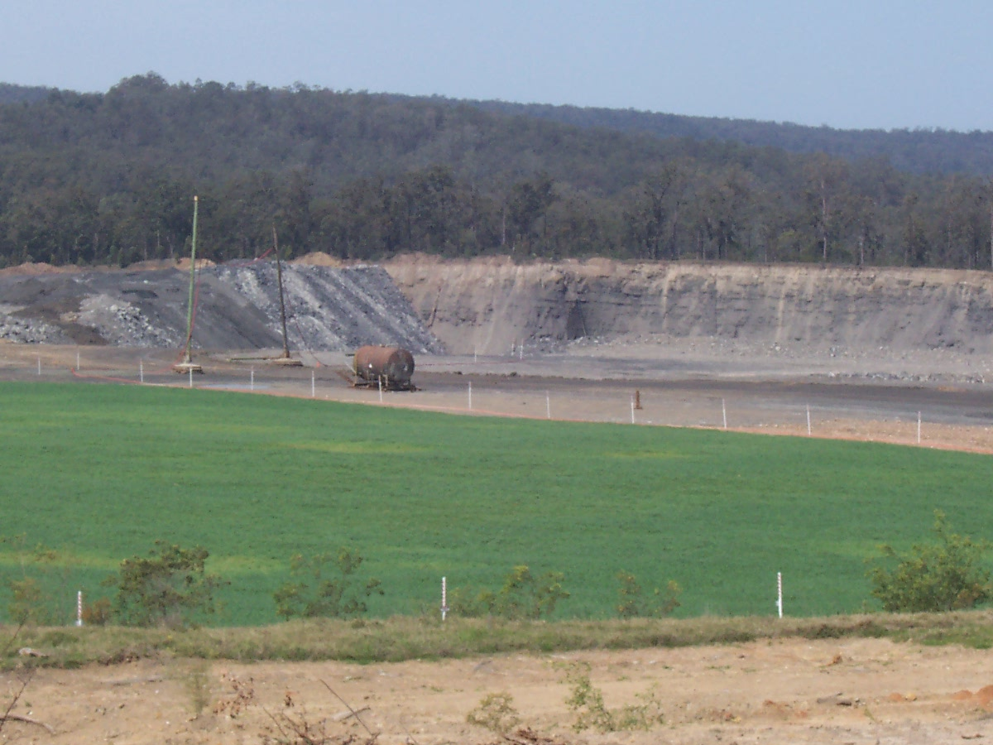
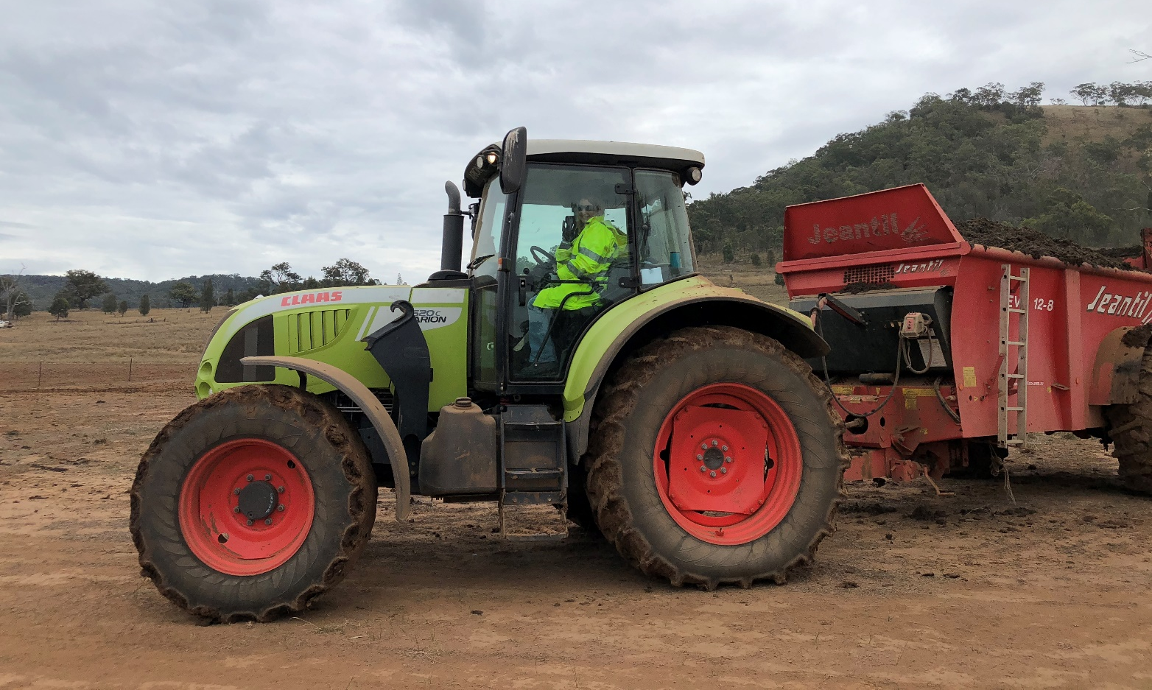
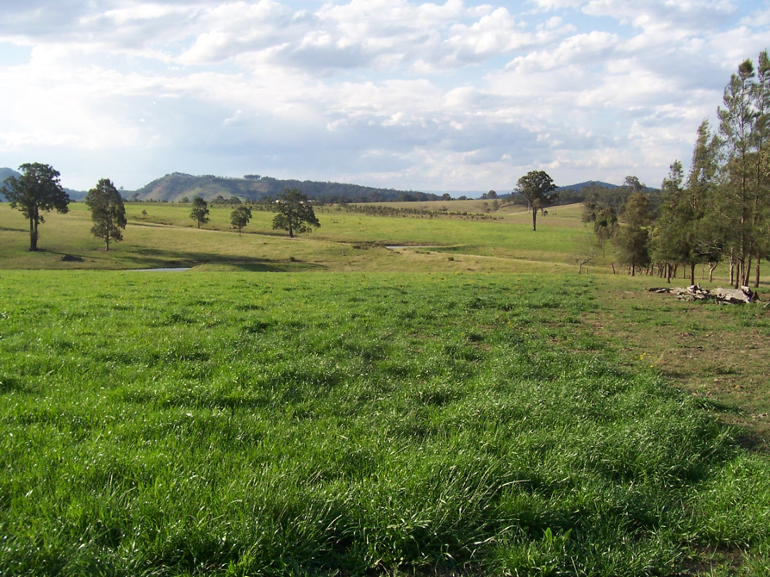
Community survey results – end use acceptance
<10% find any end use unacceptable
Higher acceptance (>70%): non-agricultural land, fuel and energy
Moderate acceptance (65%): farms and gardens; commercial fertiliser; landscaping; road fill
Lower acceptance (50%-60%): crops for human consumption; building materials
Mine rehabilitation
Agriculture
Notes:
In terms of end use, the study found most people are fairly accepting of biosolids reuse, with <10% finding any of the potential end uses mentioned in the study unacceptable.
Use on non-agricultural land (such as land rehabilitation and forestry), and for fuel and energy generation, were the most accepted end uses. These were completely acceptable to almost half of the participants (and over 70% found each of these uses acceptable to some degree);
Use on farms and gardens, in commercial fertiliser, in commercial landscaping, as road fill were the next most acceptable: Around 40% of participants considered these uses completely acceptable, and two-thirds found each of these acceptable to some degree;
Use in soil used to grow crops for human consumption, and use in building materials had lower acceptance. Around 30% considered each of these uses completely acceptable, and 50-60% of people considered each of these uses acceptable to some degree. This highlights a potential risk for the biosolids industry relying on agricultural markets into the future

Slide 16
Community survey results – key takeaways
People value biosolids benefits, but are concerned about contaminants and long-term impacts
Non-agricultural use more accepted than agricultural
Information is good! Start with basics
Proactive information campaigns are best, but reactive messaging is better than nothing
Significant opportunity for education and engagement
Use trusted sources (government/regulators, researchers, etc.)
Notes:
KEY TAKEAWAYS
People appreciate reducing pollution, recycling waste and improving soil, but they want more information about concerns such as contaminants and long-term environmental and health impacts of biosolids use.
Use of biosolids for non-agricultural purposes is more accepted than agricultural use, particularly concerning crops for human consumption.
While there is reasonable awareness of biosolids, People feel uninformed and are open to learning more about biosolids. Information is good!
But even knowledge among stakeholders involved with biosolids is highly variable, so we can’t assume people know anything. When communicating, we need to start with the basics.
Providing information increases acceptance. Being proactive with information about biosolids is best, but even reactive information campaigns are better than staying silent.
Together we have an opportunity to proactively provide people with simple information about biosolids to build familiarity and understanding.
As trusted sources, researchers and government departments or regulators have an important role to play in this education piece.

Slide 17
Outcomes
ANZBP communication plan and priorities:
Promoting and showcasing biosolids benefits
Addressing community concerns
Educational resources
Strategic partners (including ARC Training Centre)
Community engagement guidance
Notes:
This research is helping to frame ANZBPs communication plan and inform ANZBP priorities for the next few years, including:
Promoting and showcasing benefits of sustainable biosolids reuse (e.g. through trials)
Providing information regarding biosolids management challenges and issues of concern to the community
Revising and expanding educational resources (case studies, fact sheets, infographics, etc.)
Strengthening relationships with strategic partners (e.g. ARC Training Centre for Transformation of Australia's Biosolids Resource)
It also provides detailed guidance for ANZBP members on community and stakeholder engagement in relation to biosolids.

